Slide 1

Introduction
Luigi Borzì

Slide 2
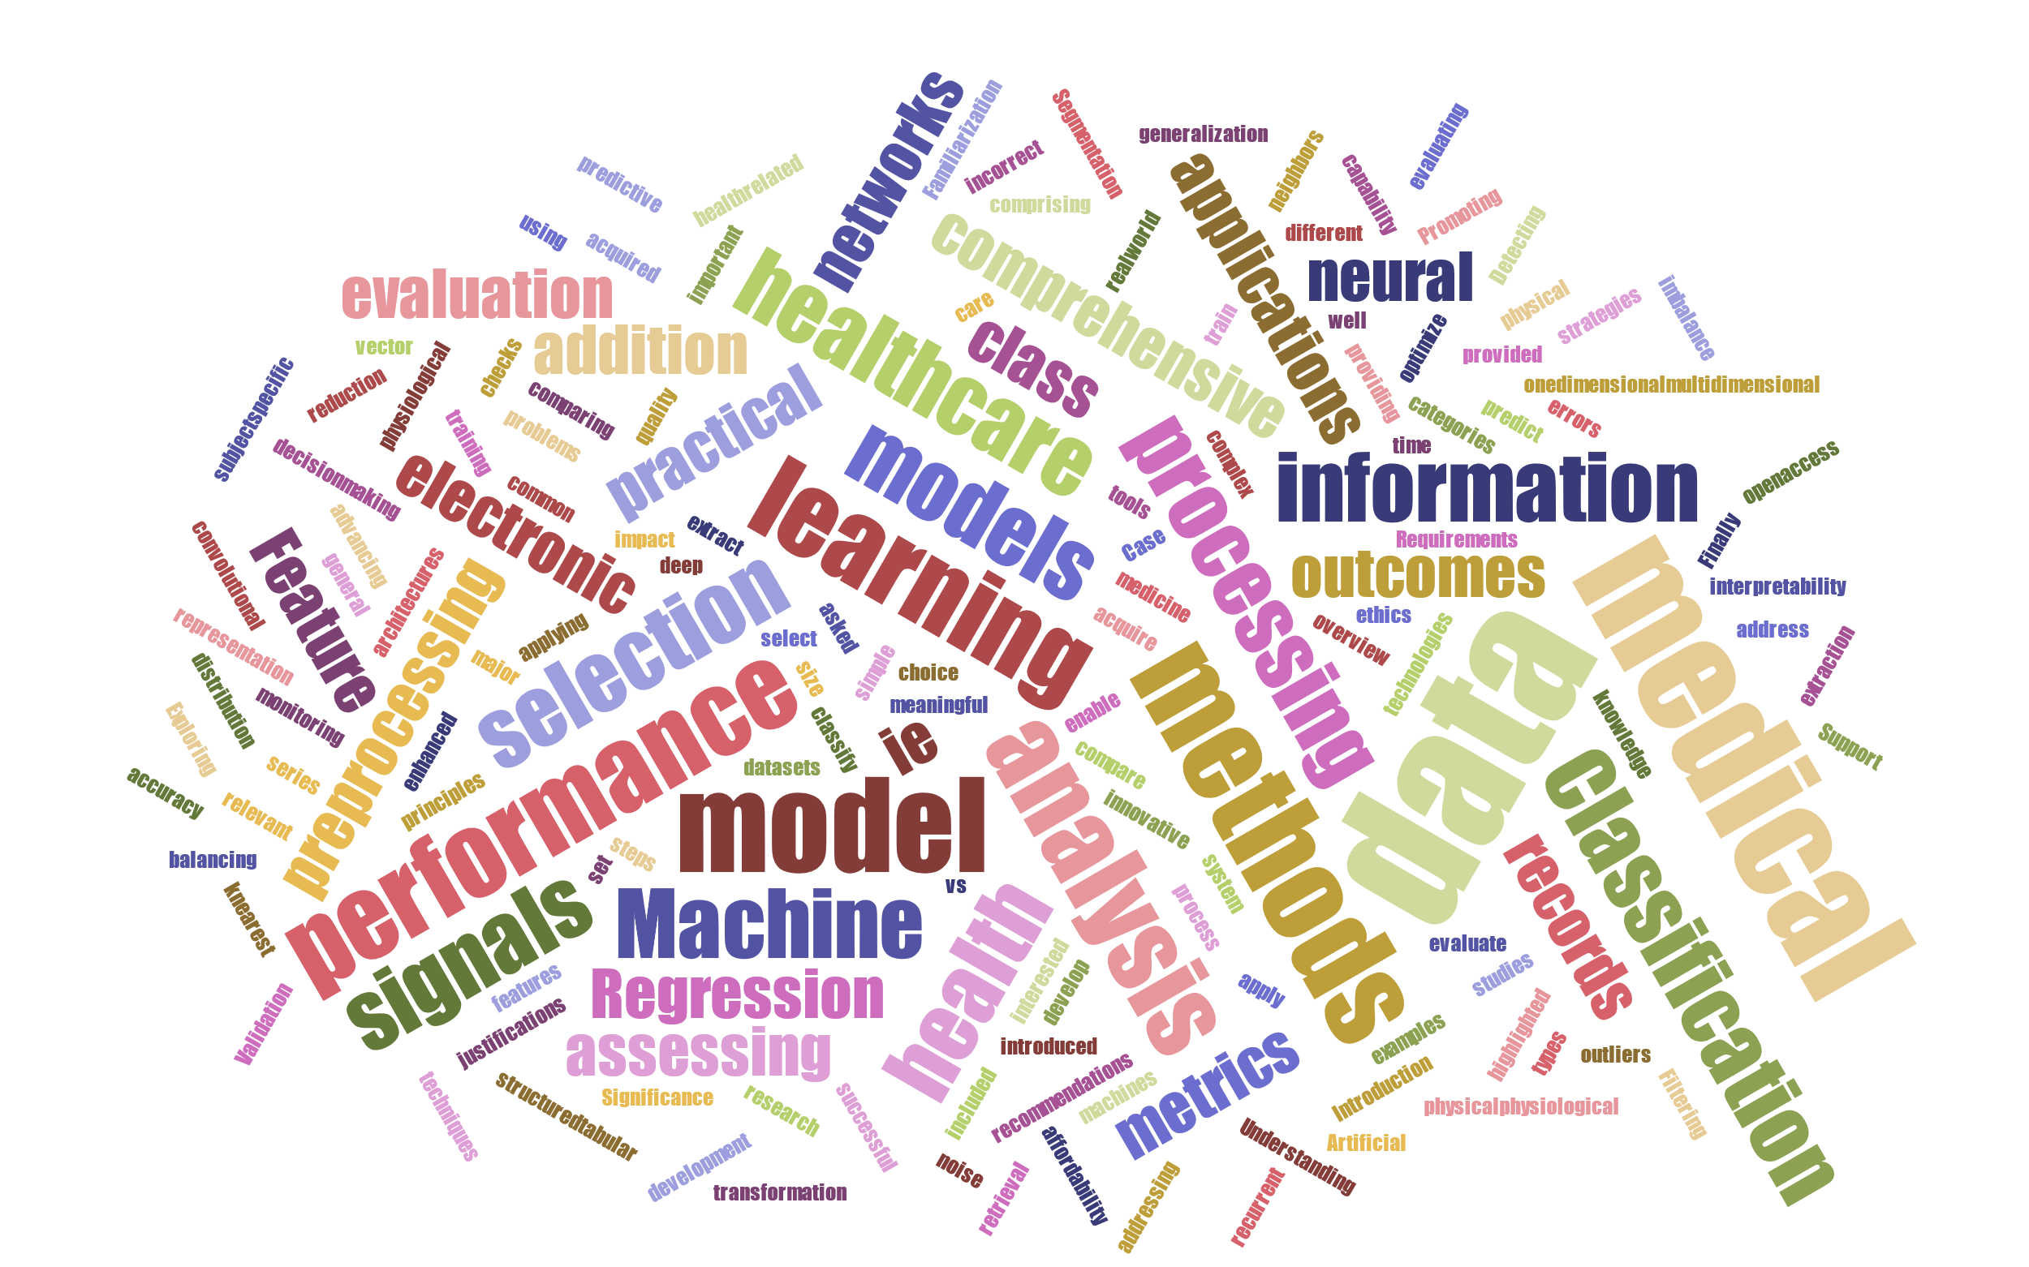
Overview

Slide 3
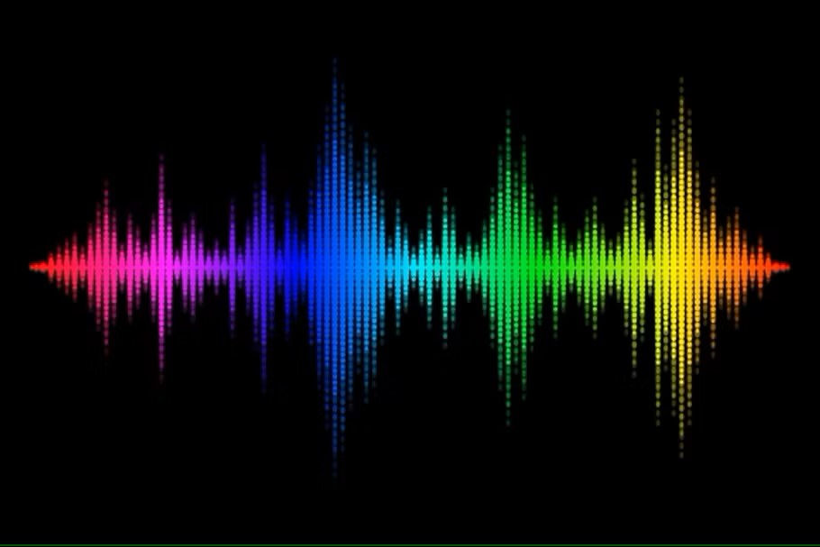
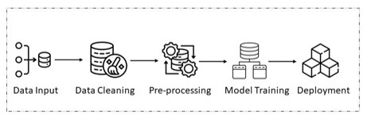
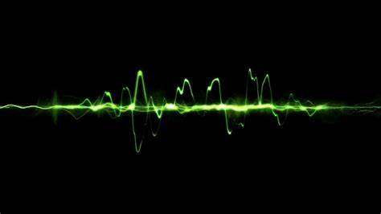
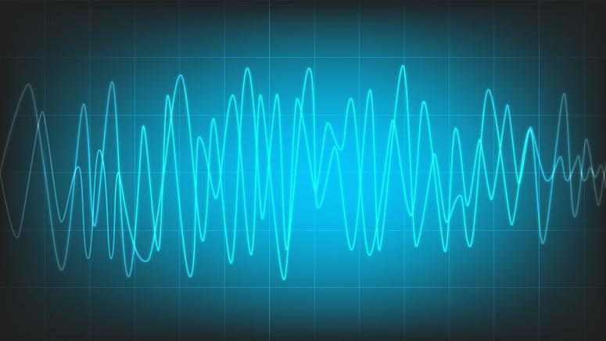
Overview
Data
Data processing

Slide 4
Overview
Data
Data processing
Data visualization and exploration

Slide 5
Data visualization and exploration
Data visualization and exploration
The importance of data visualization
Pie chart
Histogram
Scatter plot
Heat map
Spider plot
Bar chart
Correlation plot
Line plot

Slide 6
Overview
Data
Data processing
Missing values and Outliers

Slide 7
Missing values and outliers
Missing values and Outliers
Detect missing values
Recognize outliers
Handle outliers
Verify data consistency
Imputation strategies
What are missing values and outliers?
Why it is important to manage them?
Practical examples

Slide 8


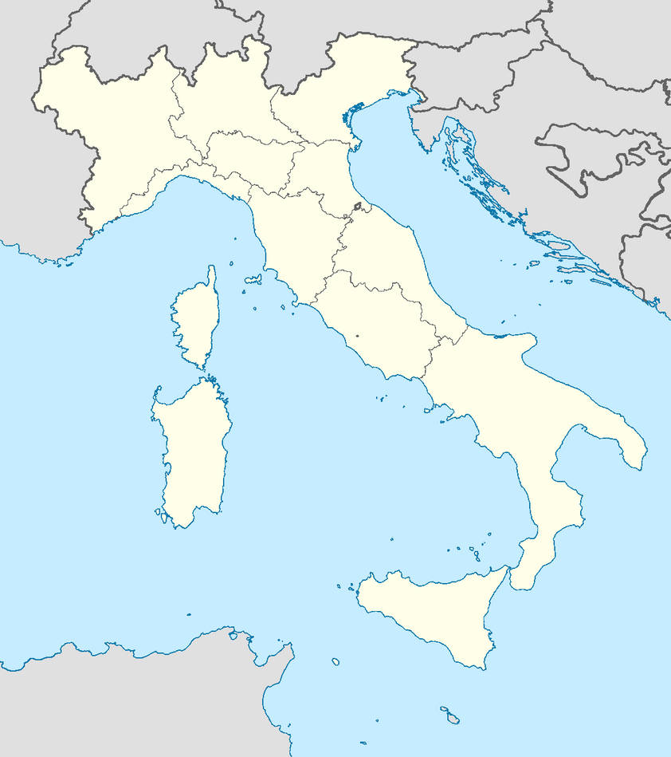

Who is me?
Luigi Borzì, PhD
Assistant professor
Department of Control and Computer engineering
Topics
Signal processing
Artificial intelligence
Wearable technology

Slide 9
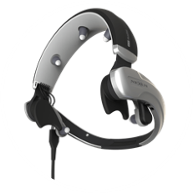
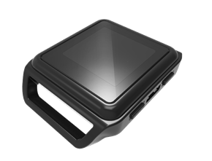
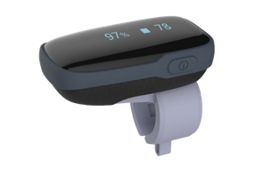
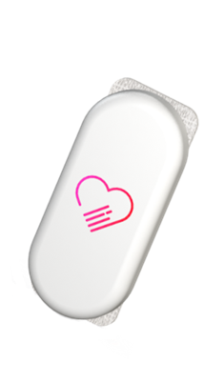
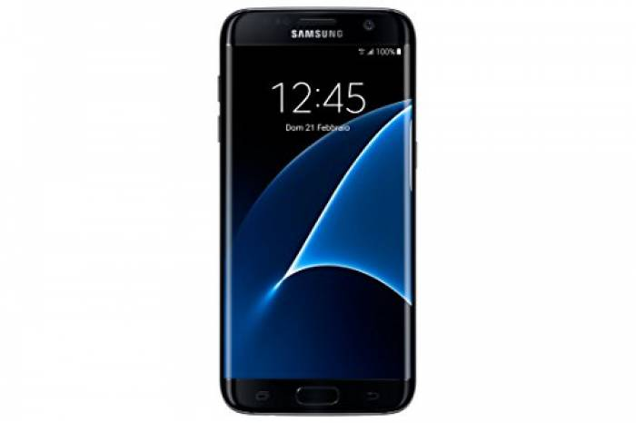
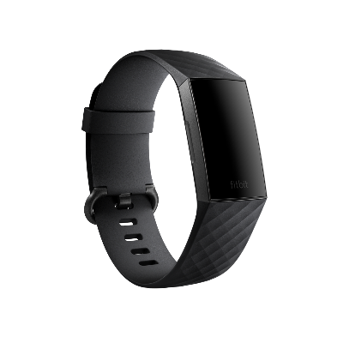
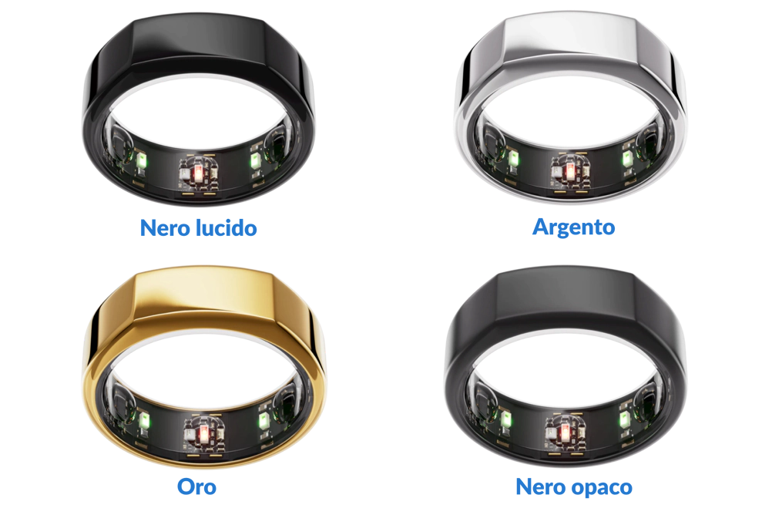
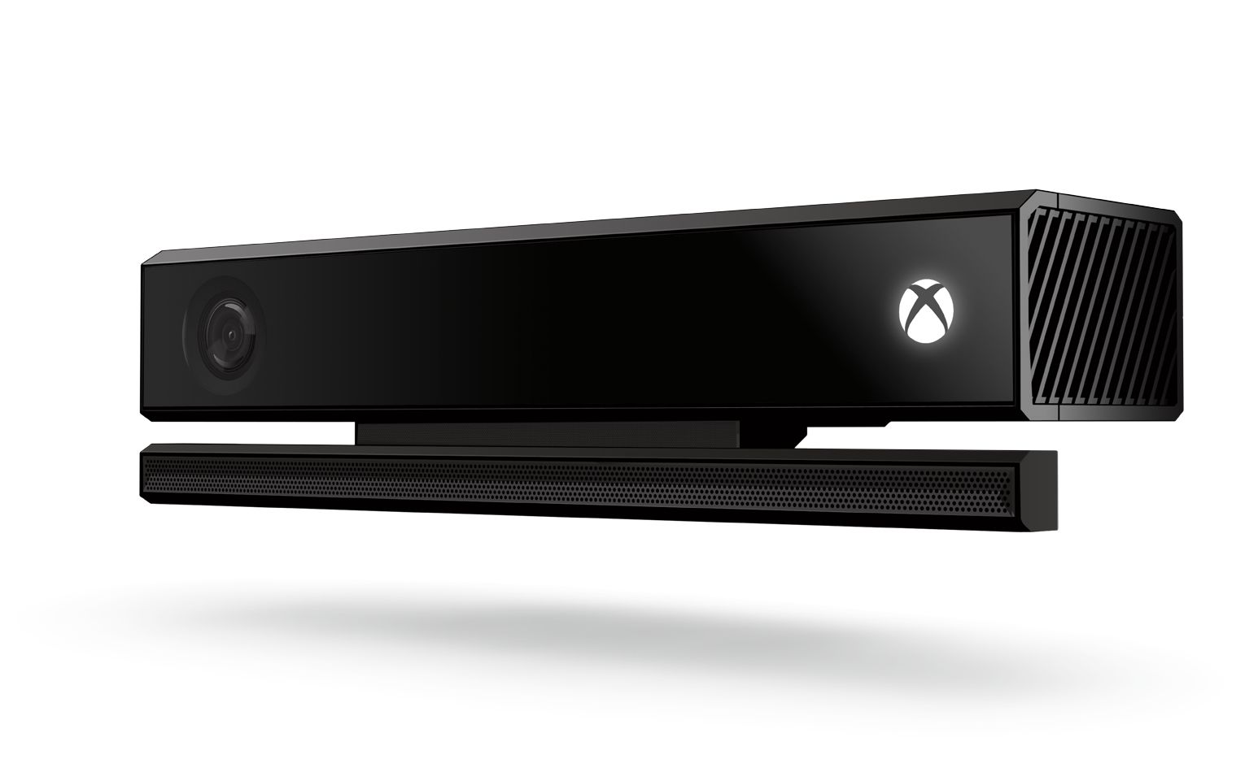
What I do?
Technologies for heath monitoring
Wearable sensors and cameras
Signal processing / Artificial intelligence
.
.
.
.
.
.

Slide 10
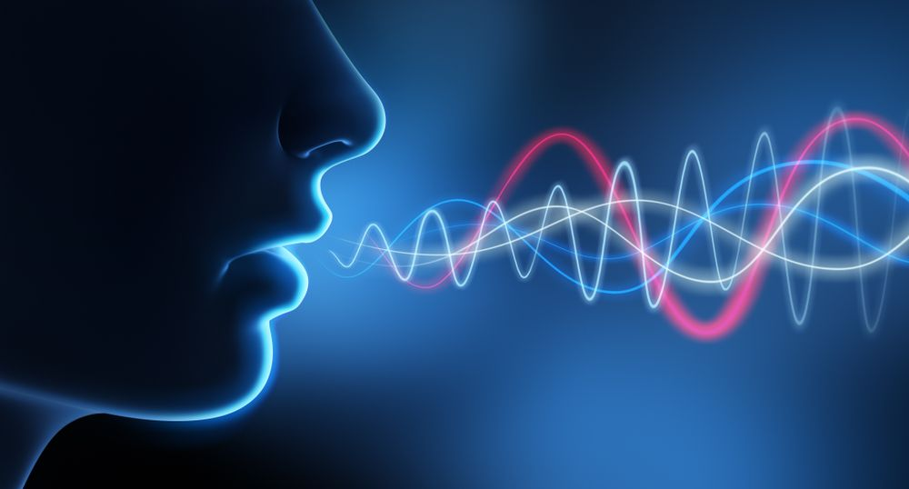
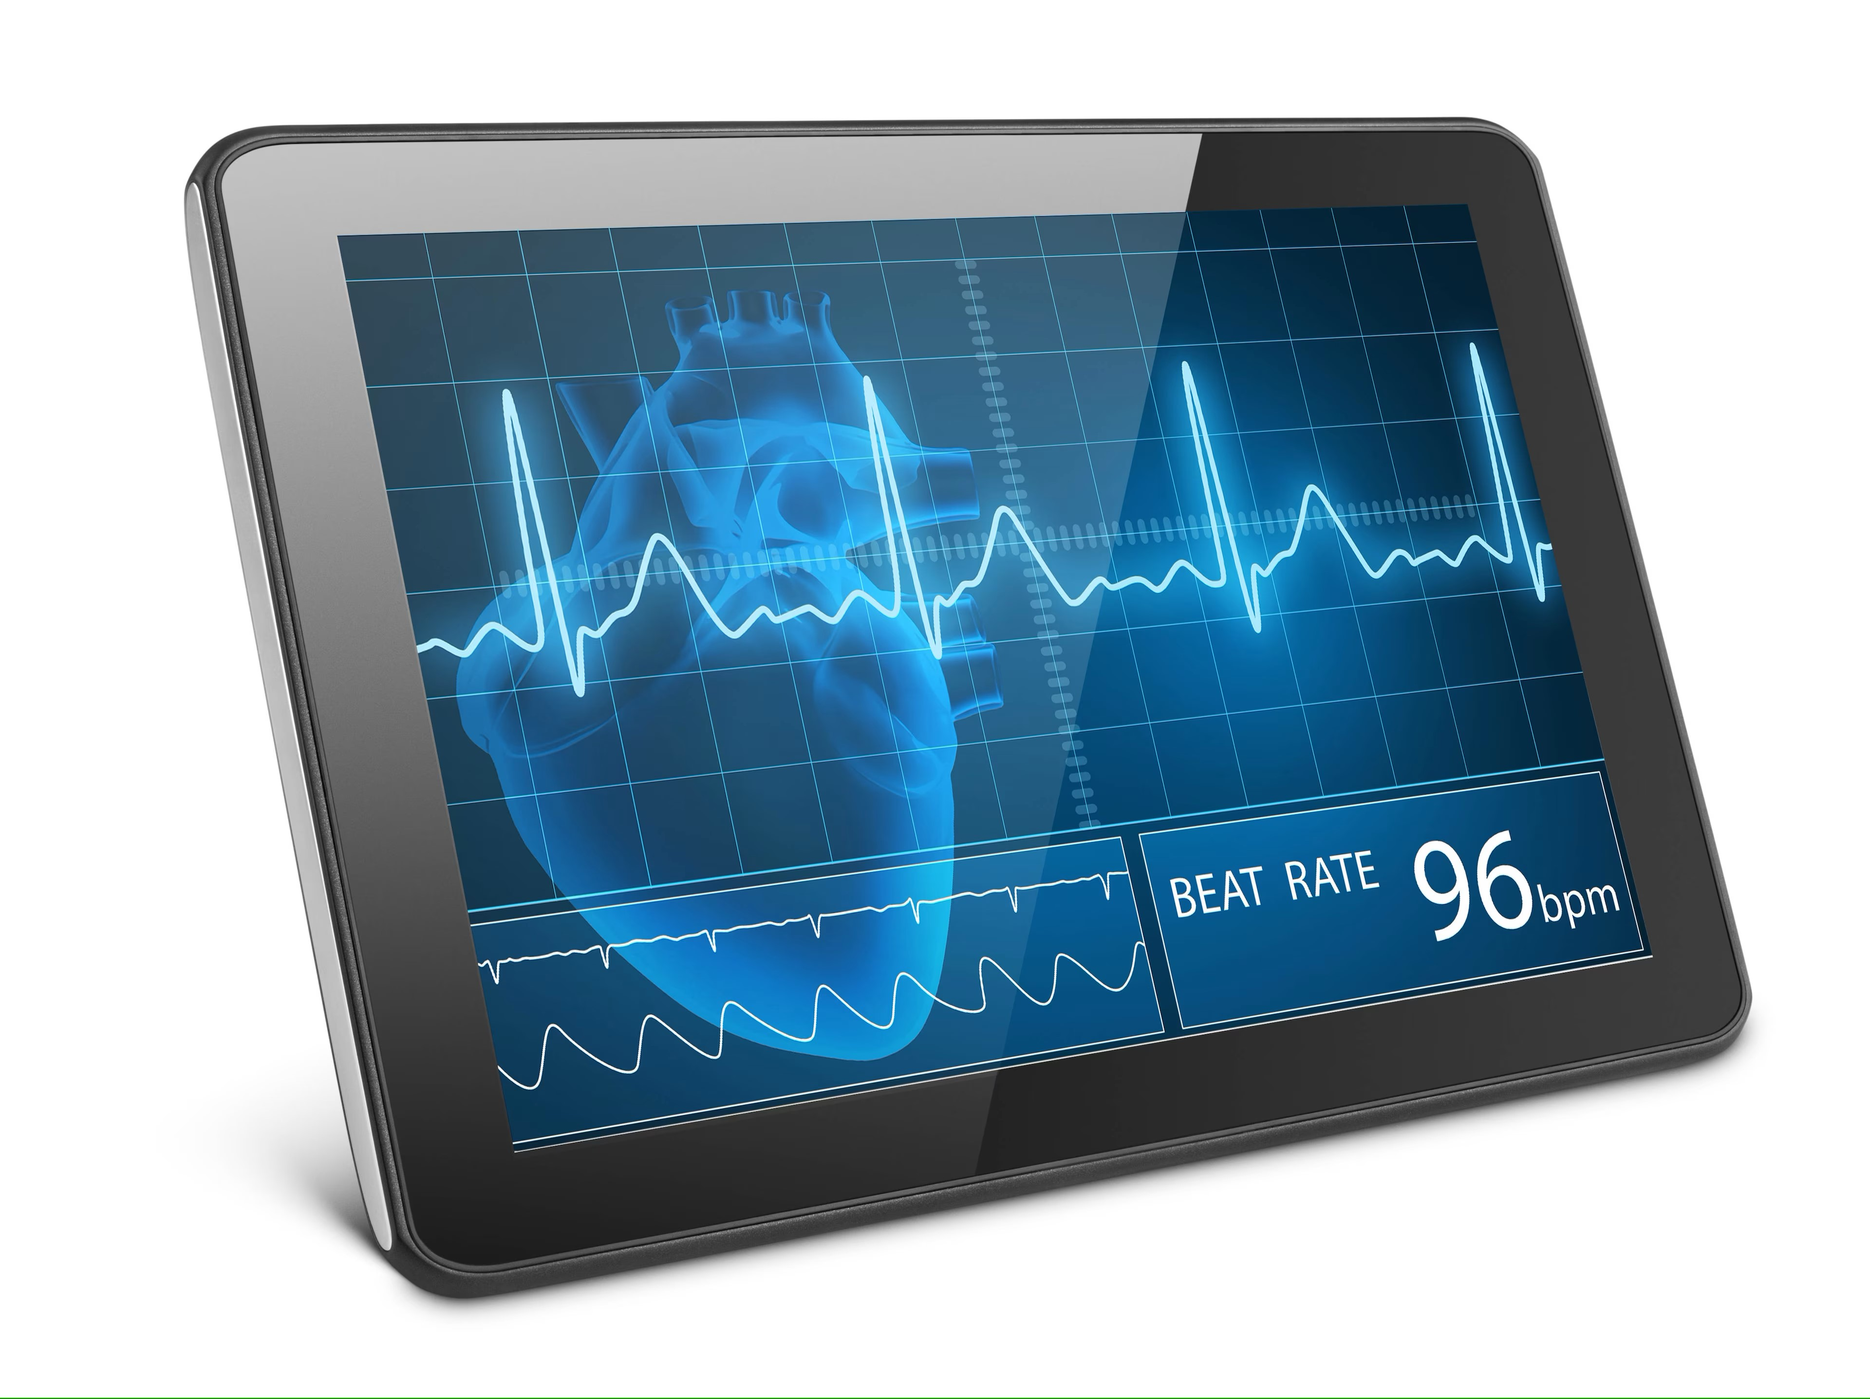

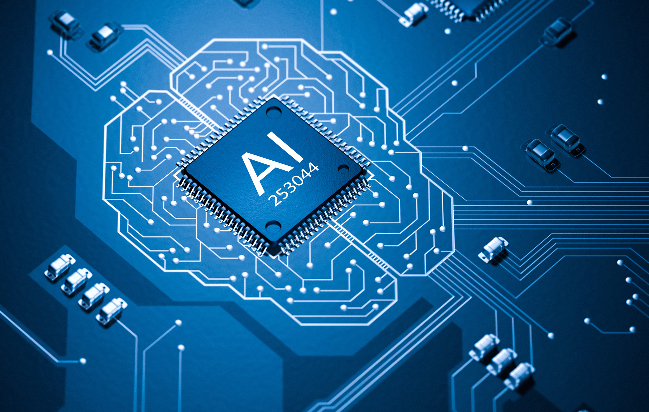

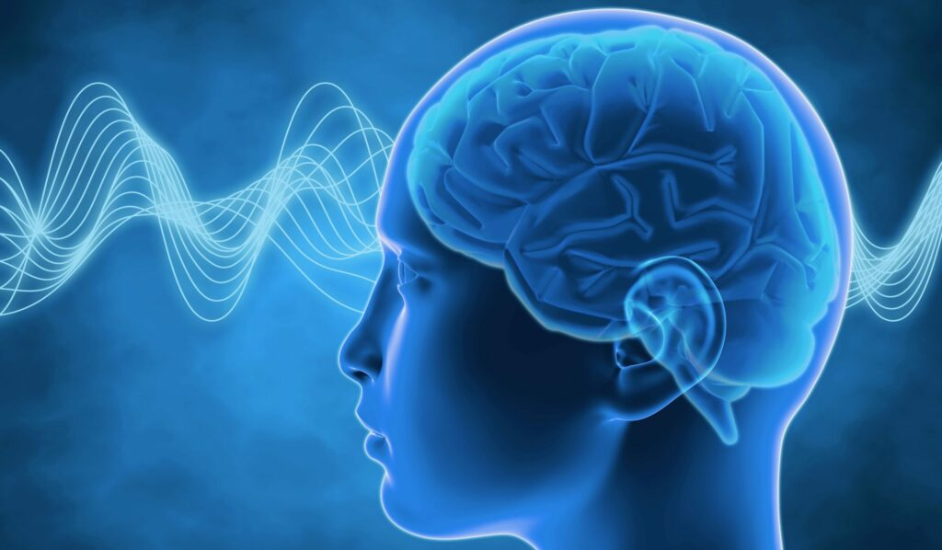
Artificial intelligence
Big amount of high-dimensional multi-modal data
Artificial intelligence
Speed up data analysis
Extract meaningful info
Anomaly detection
Find hidden patterns
Monitor changes
Predict changes

Slide 11
1. Research activities

Slide 12

Collaborations

Slide 13
Main activities
Data collection, signal processing and artificial intelligence
Applications:
Sleep monitoring
Speech analysis
Movement analysis
Rehabilitation
Stress and emotion recognition

Slide 14
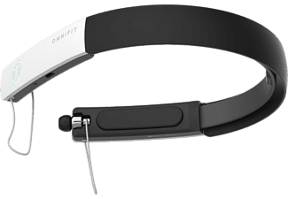

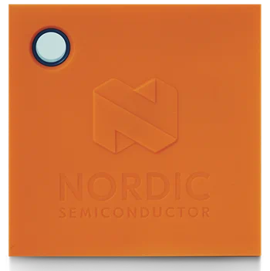

Sleep monitoring
EEG
ECG
Movimento

Slide 15
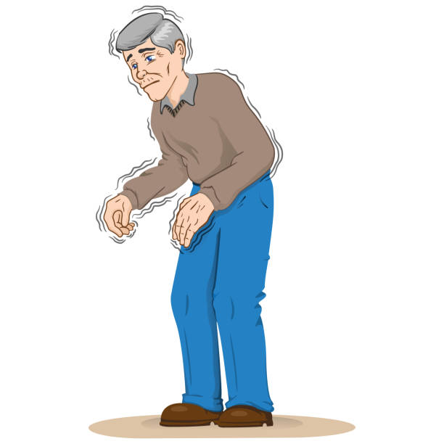

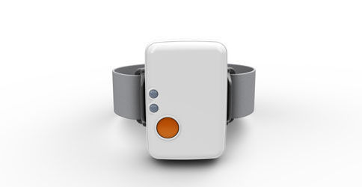
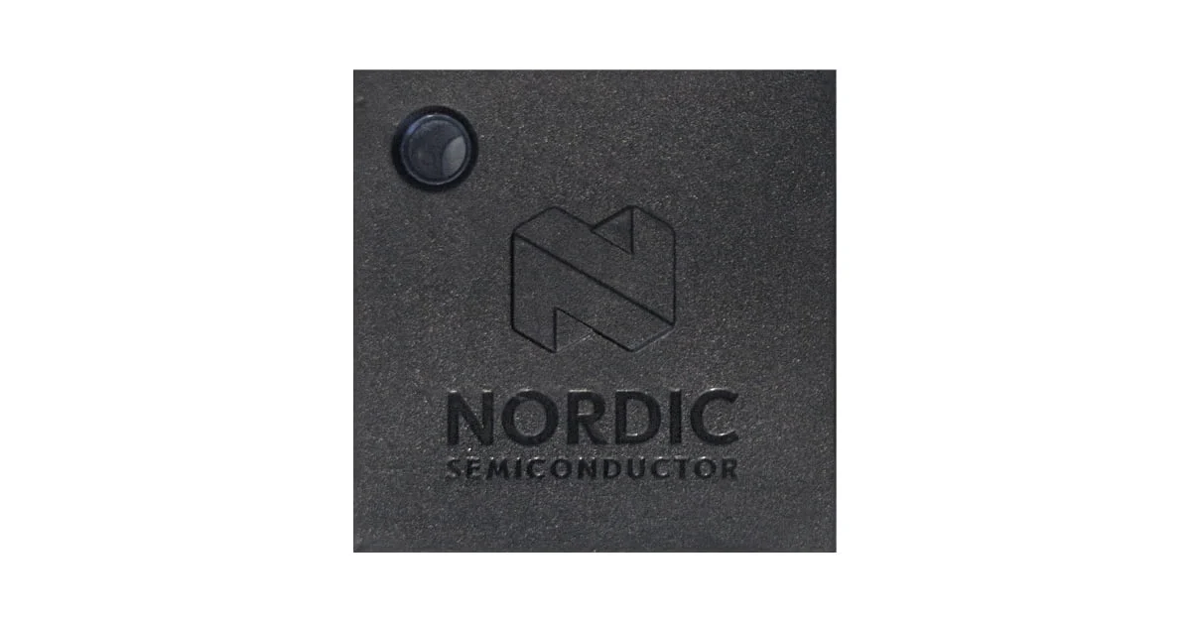
Movement analysis in Parkinson’s disease
Fall risk
Disease progression
Motor fluctuations
Threatment response
INERTIAL SENSORS

Slide 16
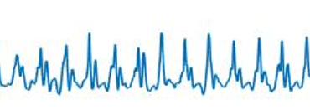

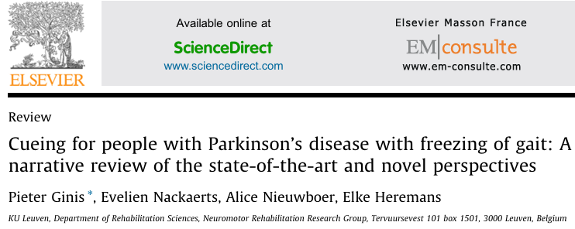
Movement analysis in Parkinson’s disease
Sensors record movement
Signals are analysed in real time
Gait impairment is recognized
Vibro-tactile stimulation is activated

Slide 17
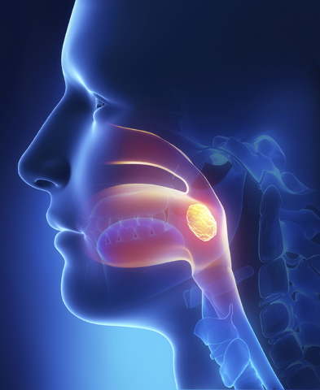
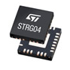
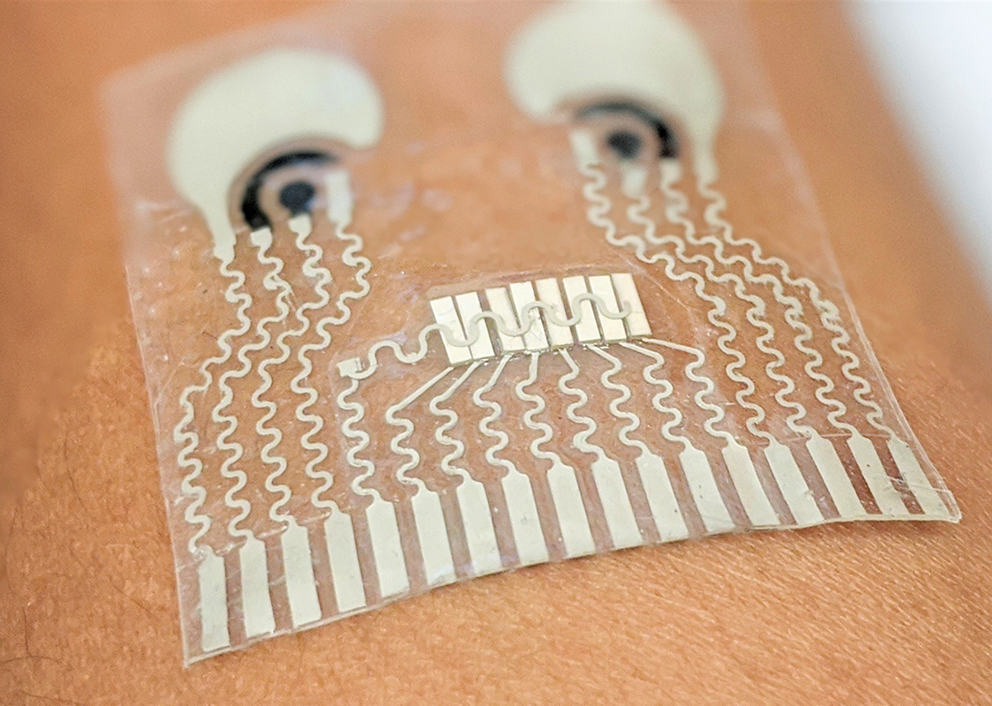
Swallowing
Movement
Muscle activity

Slide 18
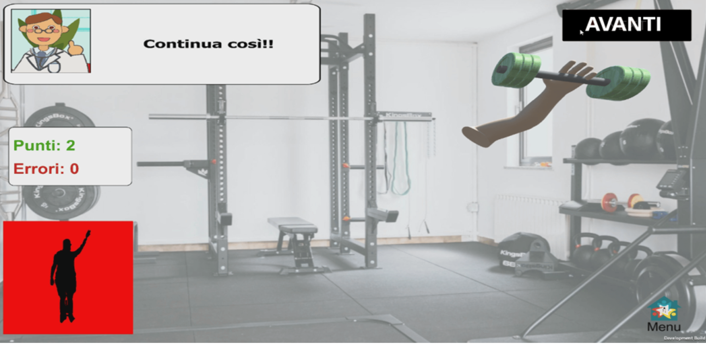
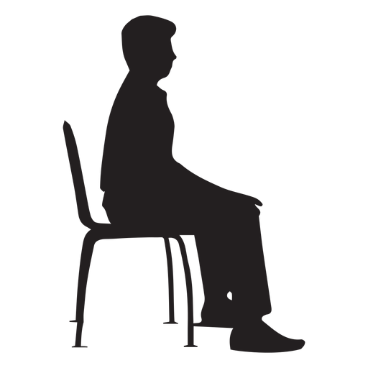
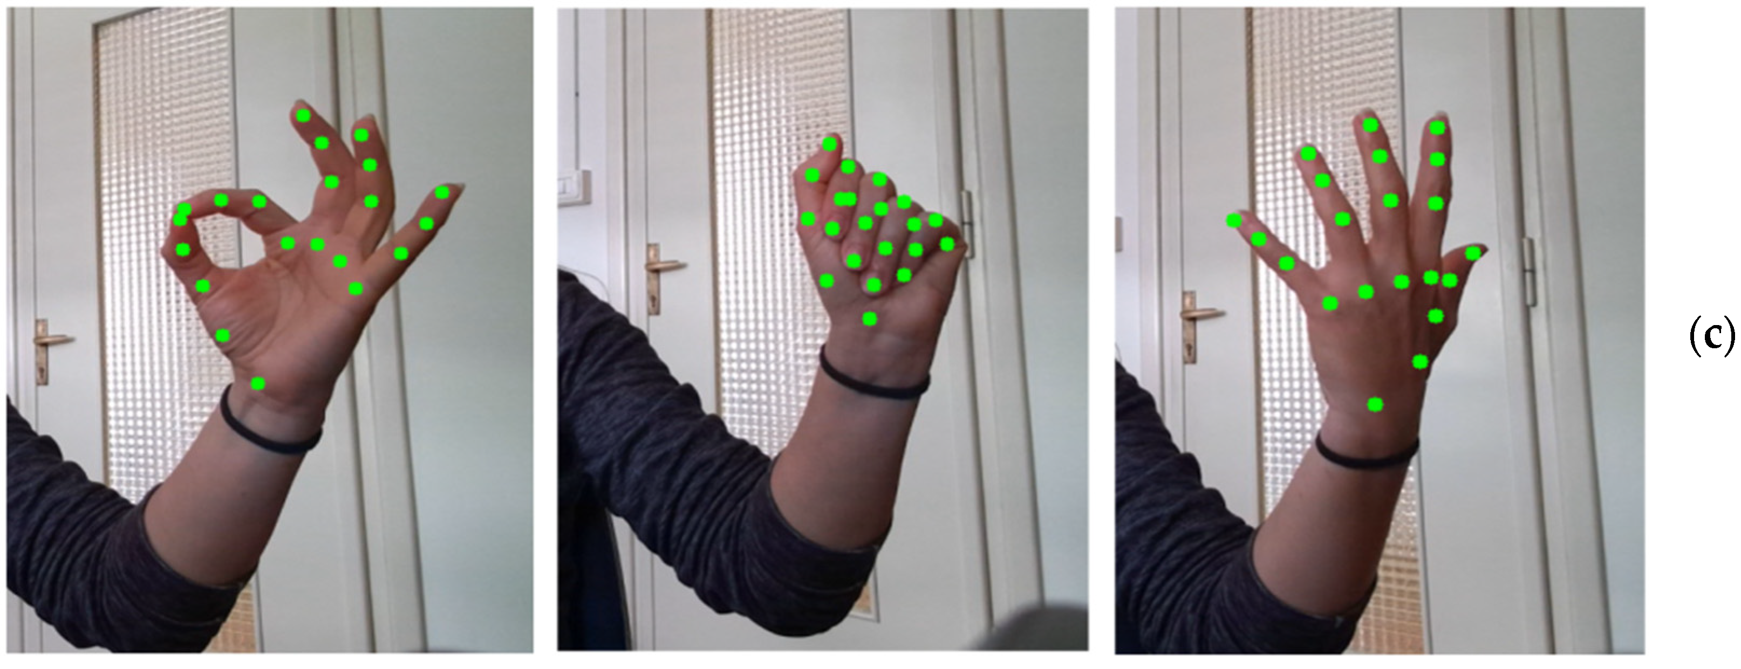
Rehabilitation

Slide 19
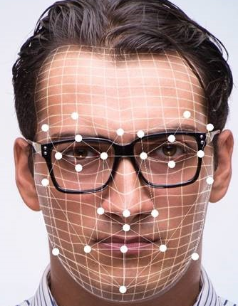
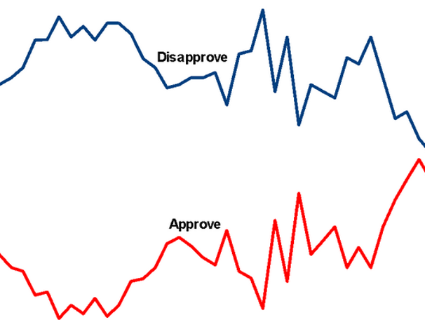
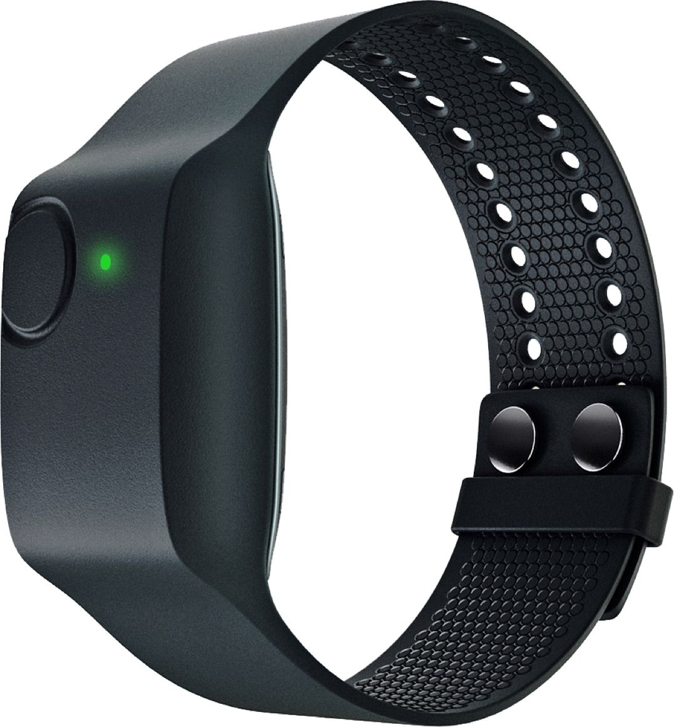
Stress and emotions
Facial expression analysis
Physiological signals analysis

Slide 20
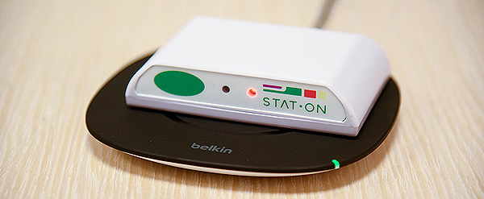
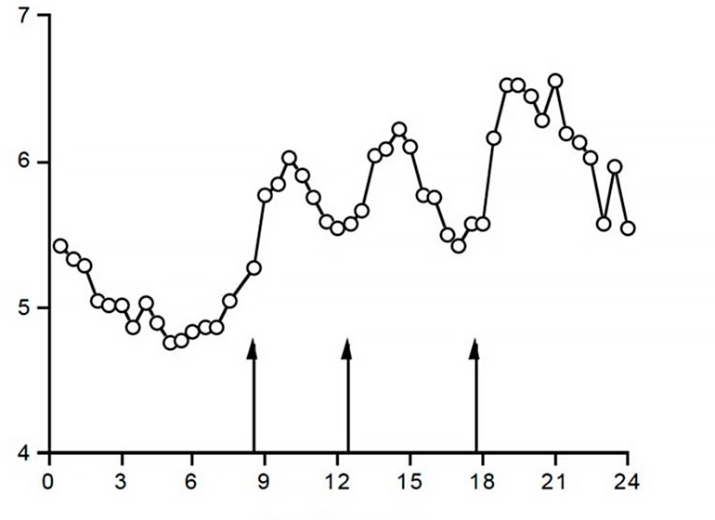
Home monitoring
Medical device(class IIa)
Battery life: 7 days
Recording : 8h/day

Slide 21
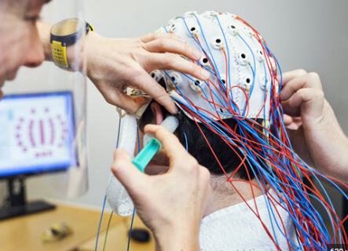
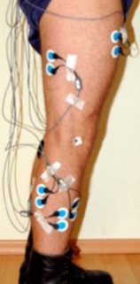
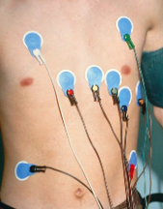
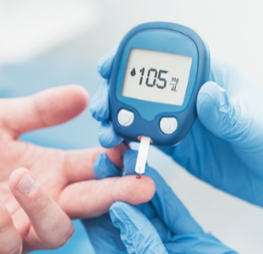
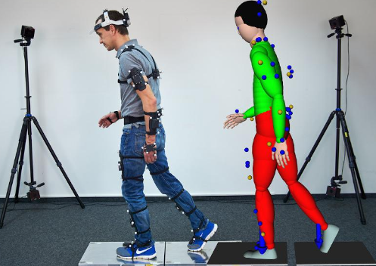
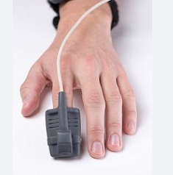
Data
Continuous, non-invasive data collection
Heart rate
Respiration
Oxygen saturation
Movement
Pressure
Voice
Temperature
Location
Sweating

Slide 22
Artificial intelligence
A huge quantity of data is collected!
Artificial intelligence
Speed up analysis
Information extraction
Anomaly detection
Find hidden patterns
Monitor changes over time
Predict complications

Slide 23
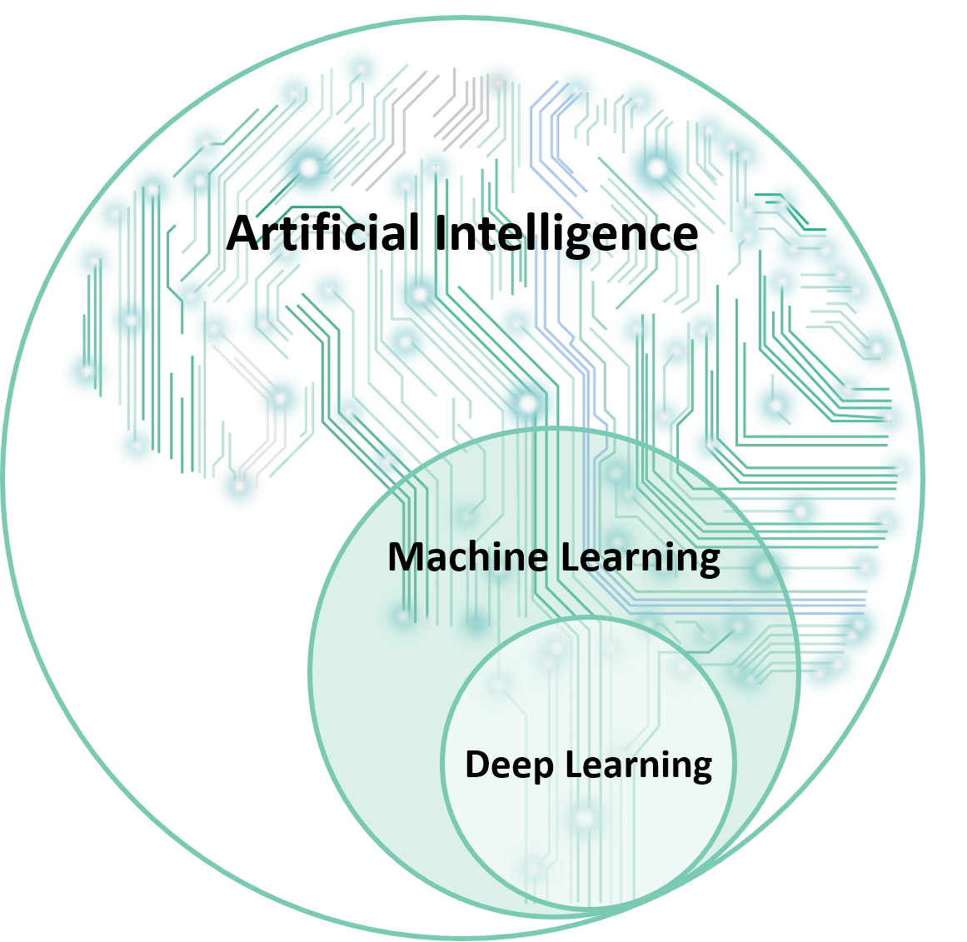
Artificial intelligence
Field of computer science that focuses on creating systems capable of performing tasks that typically require human intelligence
Subfield of artificial intelligence that includes the development of algorithms and models that enable computers to learn and make predictions or decisions based on data without explicit programming.
Sottocampo dell'apprendimento automatico che prevede l'uso di reti neurali complesse che imparano direttamente dai dati.

Slide 24
Artificial intelligence
Subject | Age (years) | Gender | Blood pressure (mmHg) | Heart rate(bpm) | Glucose level(mg/dL)
1 | 45 | Male | 120 | 72 | 90
2 | 35 | Female | 110 | 65 | 95
3 | 50 | Male | 130 | 80 | 105
4 | 28 | Female | 115 | 68 | 88
5 | 50 | Male | 130 | 85 | 120
6 | 32 | Female | 118 | 70 | 98
7 | 55 | Male | 135 | 85 | 95
8 | 40 | Female | 112 | 60 | 92
9 | 48 | Male | 125 | 75 | 102
10 | 38 | Female | 120 | 70 | 100
…
…
N | 40 | Female | 112 | 60 | 95
IF 60 < heart rate < 90 AND blood pressure < 120 AND glucose level < 100 → THEN condition: normal
IF 90 < heart rate < 120 AND 120 < blood pressure < 140 AND 100 < glucose level < 125 → THEN condition: at risk
If heart rate = 0 → THEN condition: dead

Slide 25
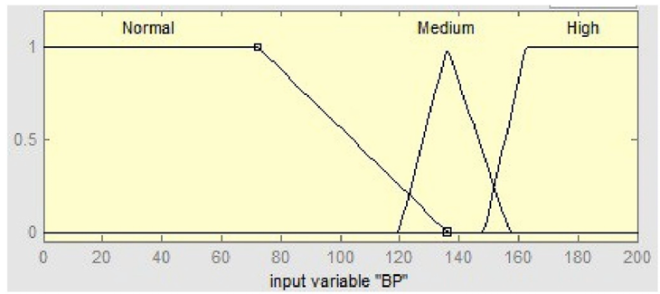
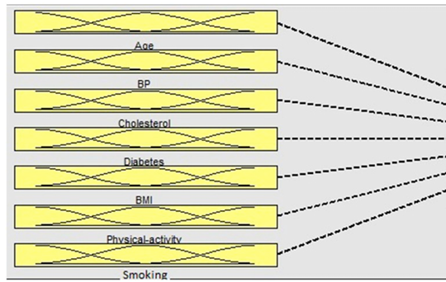
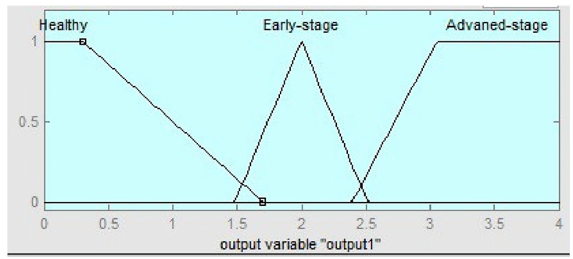
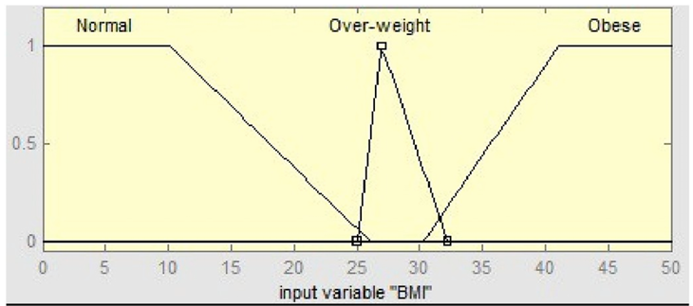
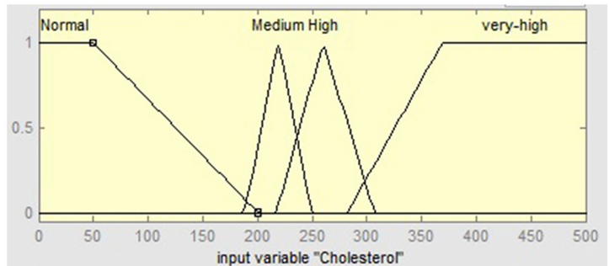
Artificial intelligence

Slide 26
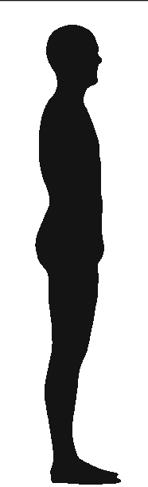
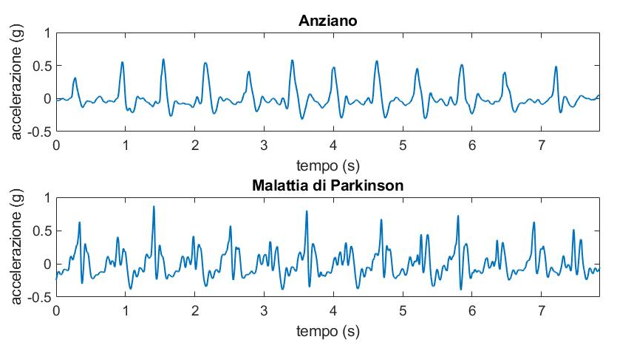

Machine learning

Slide 27






Machine learning
Control
Amplitude | Frequency | Regularity | Symmetry | Class
1.5 | 12 | 2.5 | 0.8 | PD
1.8 | 8 | 2.1 | 0.9 | Control
1.6 | 6 | 1.8 | 1.2 | Control
1.2 | 15 | 1.5 | 1.1 | PD
2.5 | 12 | 1.4 | 0.7 | PD
3.2 | 11 | 1.6 | 1.35 | Control
2.8 | 8 | 1.2 | 0.75 | PD
PD

Slide 28


Machine learning
Amplitude | Frequency | Regularity | Symmetry | Class
1.5 | 12 | 2.5 | 0.8 | PD
1.8 | 8 | 2.1 | 0.9 | Control
1.6 | 6 | 1.8 | 1.2 | Control
1.2 | 15 | 1.5 | 1.1 | PD
2.5 | 12 | 1.4 | 0.7 | PD
3.2 | 11 | 1.6 | 1.35 | Control
2.8 | 8 | 1.2 | 0.75 | PD
Amplitude<2?
Frequency>10?
Regularity>1.5?
PD
Control
Control
PD

Slide 29

Machine learning
The decision tree is the simplest machine learning model.
It is fast, easy to visualize and thus interpretable.
However, it is not the most convincing.
Usually, instead of choosing sharp thresholds, it is preferred to maximize the separation between classes.

Slide 30

Deep learning

Slide 31
2. Examples

